Slide 1
To-Do List Project Presentation
Harry Fresco

Slide 2
Contents
Introduction
Consultant Journey
CI
Testing
Demo
Sprints
Conclusion

Slide 3
Introduction
Overview of how I approached the specification:
User stories and created Jira board
Designed database with UML
Created object classes and their DTOs and Controllers in Spring
Left time for front-end development
Implemented variety of testing throughout, such as Junit, Mockito, Selenium

Slide 4
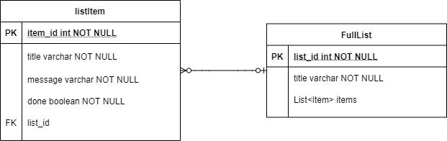
Database design
This was the original Database design that remained the same throughout development.
The List Entity had to be called FullList as List was a keyword in Java.
The requirements surprisingly didn’t change throughout development.

Slide 5
Consultant Journey
Knew Java, Junit, Maven, Jira, from previous project
HTML and JavaScript from Uni, but never went well
Spring
SonarQube
Selenium

Slide 6
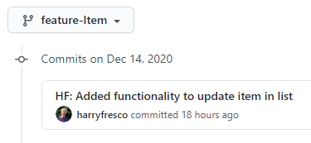
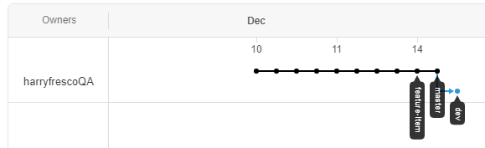
CI
Used Main/Dev/Feature branches
Main
Dev
Feature
Used for when a specific feature is being developed and code may not compile
Such as feature-item
Merged to dev when complete

Slide 7

CI
Occasionally used smart commits to connect to Jira
Not fully utilised

Slide 8
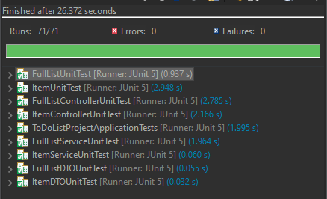

Testing
Consisted of Junit testing, Mockito, and Selenium
Junit
Domains, DTO’s
Mockito
Controllers, Service
Tested the whole system against user stories.
Example: As a User, I want to create a list to that I can add items.

Slide 9
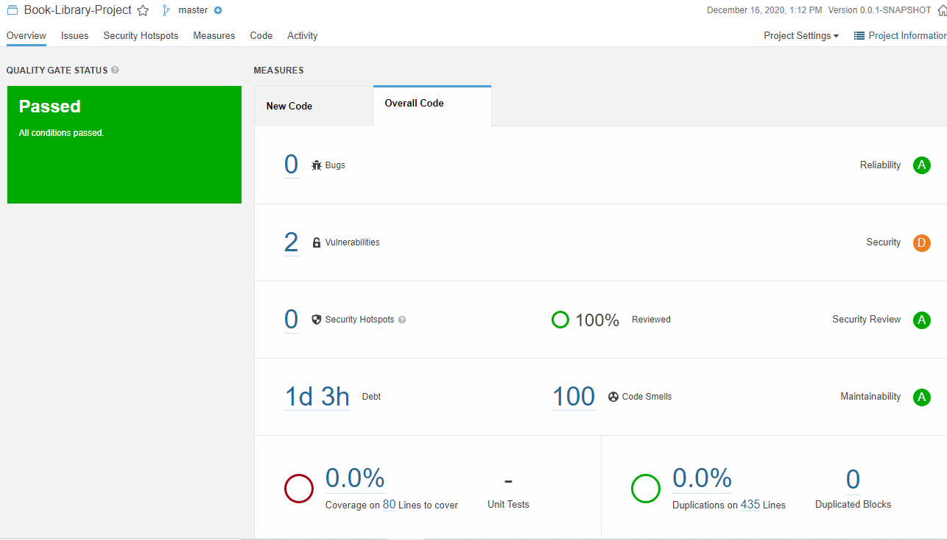
SonarQube

Slide 10
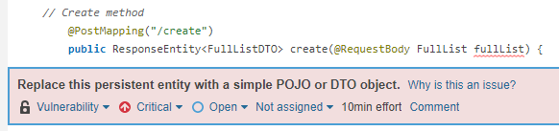
SonarQube
Shows vulnerabilities in code
2 Vulnerabilities were the create mapping in the controllers.
Entities should not be used as arguments of "@RequestMapping" methods
Tried to fix but required mass refactoring of code, (both front and back-end) did not have time

Slide 11
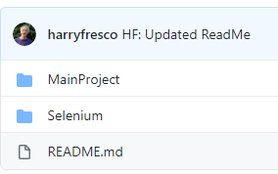
Selenium
Used Selenium to perform user-acceptance testing.
Was only able to implement two methods:
Create List
Create Item in list
In it’s own project.
Needs MainProject running

Slide 12
Demo
To demonstrate:
List – CRUD
Item – CRUD – and mark as ‘Done’

Slide 13
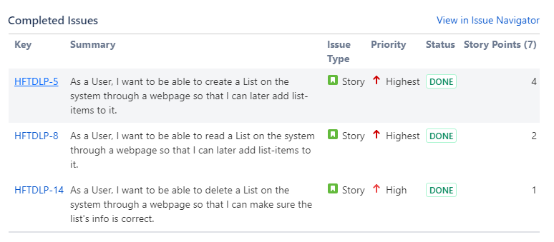
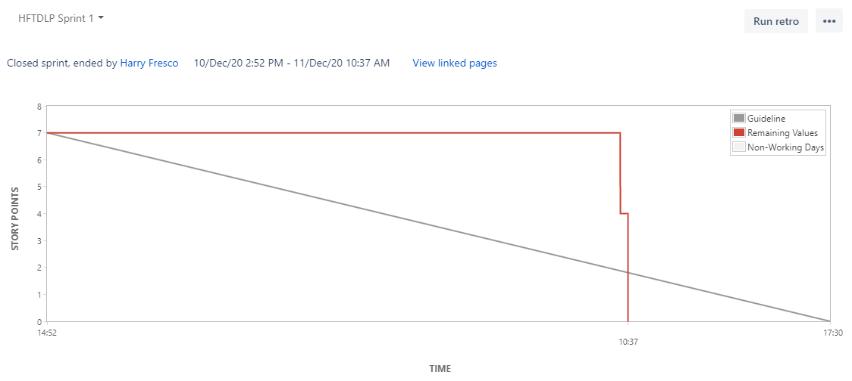
Sprint 1
Was to do with lists and their CRUD functions (without update)
Took a while to get a strong back-end but after that it went easier
Updating Item was prolonged until a later sprint because from previous project, updating items took longer than predicted. (MVP)
Used Postman to test first and then created a very basic HTML page
Used H2 to host local database while testing

Slide 14
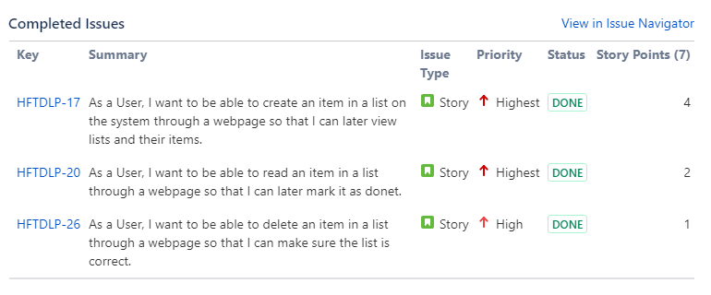
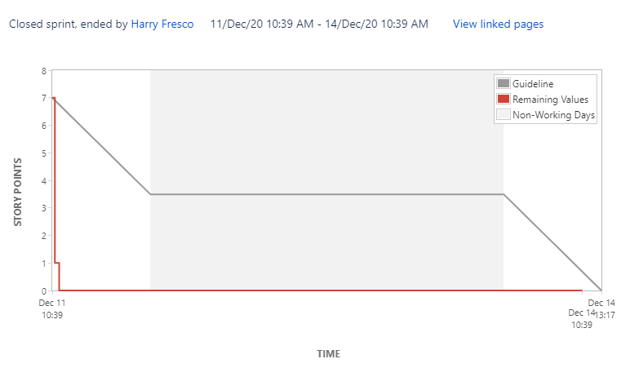
Sprint 2
Was to do with items in lists and their CRUD functions (without update)
As list functionality was already created, it was a very easy sprint to complete
Updating lists was also prolonged until the next sprint.

Slide 15
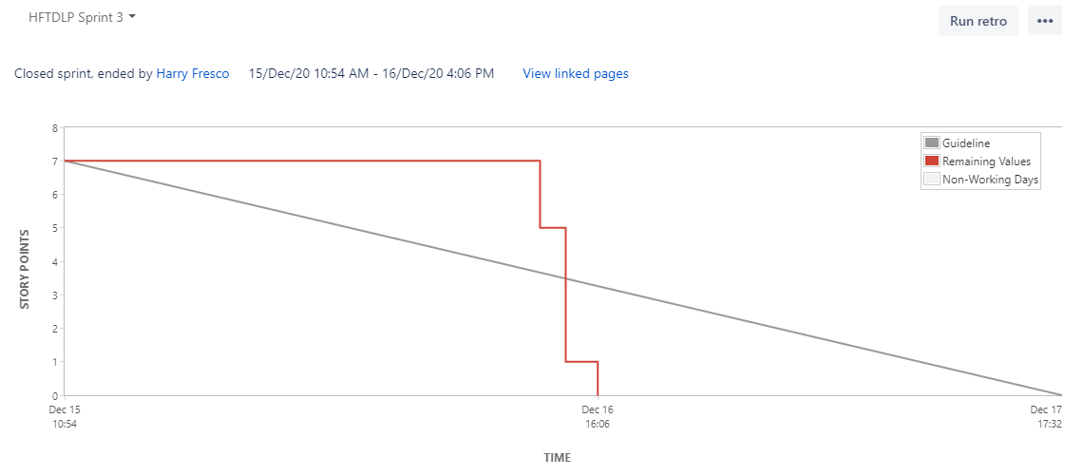
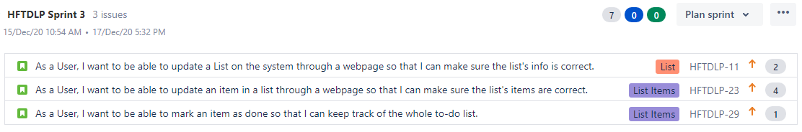
Sprint 3
Was to do with items and lists
Had a few issues with CORS
Once Lists can be updated, this made Items be updated easier.
The marking of an item as done was very easy, as it required changing a bool value and adding a strikethrough on the HTML text.

Slide 16
conclusion
What went well
Database design and implementation
Using Jira again, helped layout the project
Adding and deleting items from Lists
Back-end was implemented quickly, left time to neaten front-end
What I enjoyed
Creating and neatening the HTML webpage
Finding a way to show that an item was marked as done
Selenium was very intuitive
What could be improved
An even more intuitive way to display the lists and their items
Refresh the page when adding items
Remove the vulnerabilities shown in SonarQube
More Selenium Tests
JavaScript could have been laid out better, more separate functions
What have I taken away / is useful for future
Always start by testing with Postman and then create a very basic front-end before implementing things like Bootstrap
Using Jira is very useful to get a project started

